Slide 1
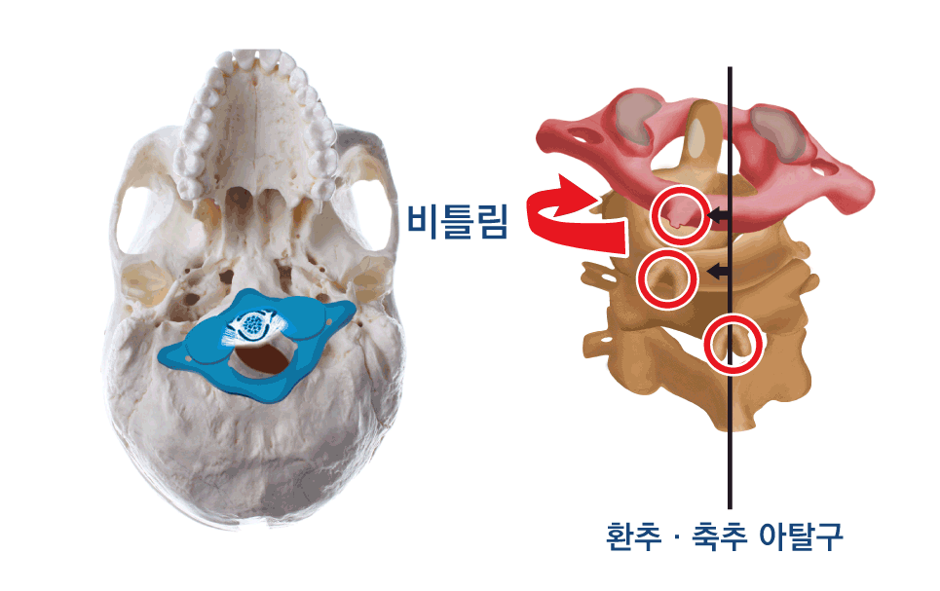
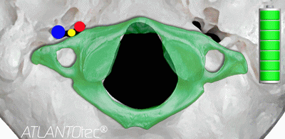
Impact of Atlas and Axis distortion
Jugular Foramen(CN 9,10,11)
Restricts the space of foramen magnum and jugular foramen causing Central and Cranial nervous system related disorders

